Slide 1
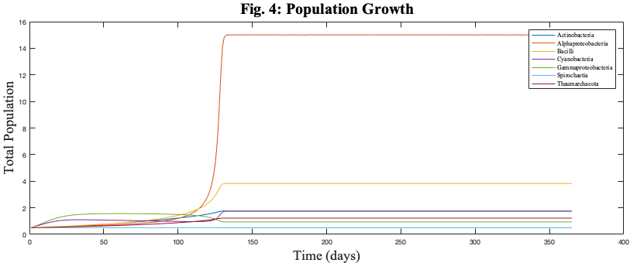
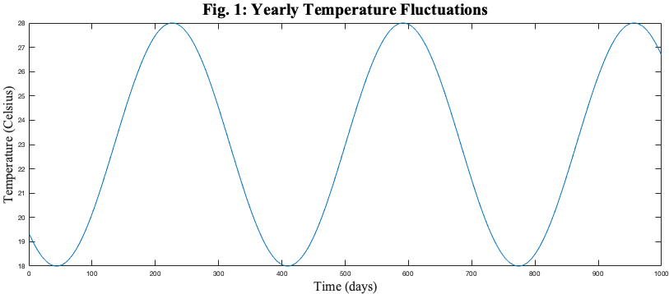
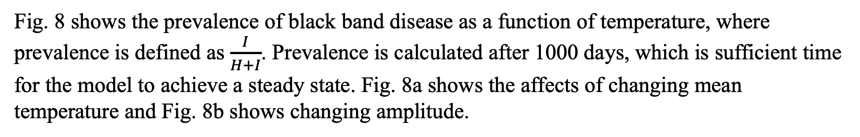
Mathematically modeling the coral reef microbiome
Maya Weissman¹, Naveen Vaidya¹, Lais Lima², and Elizabeth Dinsdale²
¹SDSU Disease Modeling Lab, Department of Mathematics; ²SDSU Dinsdale Lab, Department of Ecology
I. Abstract
II. Introduction
Coral reefs are some of the most diverse and valuable ecosystems on the planet, but an estimated 20% of the world’s reefs have been decimated due to stressors such as climate change, coral bleaching, and diseases. Pseudodiploria strigosa is a reef-building species abundant in the Caribbean that is currently being threatened by black band disease. P. strigosa, like all other coral colonies, functions as a holobiont where the coral animal relies on a symbiotic relationship with a complex microbiome. The composition and health of the microbiome is affected by high temperatures, eutrophication, and other stress conditions. In this poster, we present mathematical models, developed based on P. strigosa microbiome data collected from Bermuda (Dinsdale Lab at SDSU), in order to investigate the relationship between environmental conditions, the coral reef microbiome, and black band disease dynamics. In particular, we focus on evaluating the effects of temperature on the coral reef microbiome, which emulates the periodic changes in microbiome composition found in nature. The microbiome model is further extended to predict black band disease dynamics and identify the environmental threshold conditions that would cause the reef holobiont to shift from a healthy to a disease-associated microbial community. Our results show that temperature can have significant impact on the coral reef holobiont health, and can account for susceptibility to black band disease. Our models can be used to investigate potential strategies to protect reef ecosystems from black band disease and other stressors.
Coral reefs are home to a quarter of all ocean species, despite covering less than one percent of the earth’s surface. Due to stressors such as climate change, coral bleaching, and disease, almost 20% of the world’s reefs have been destroyed. Coral colonies function as a holobiont, where the coral animal, such as the reef building coral Pseudodiploria strigosa, depend upon a complex community of microorganisms. The coral microbiome is an important driver in the fitness of the coral reef, although the exact nature of this relationship is still not understood.
In this project, we hypothesize that temperature drives microbiome composition, which in turn affects the reef’s susceptibility to black band disease. We develop a mathematical model that simulates microbiome growth as a function of temperature, network interactions within the holobiont, and the relationship between the microbiome and black band disease.
Our model was developed using data collected by the Dinsdale Lab. Ocean samples from P. strigosa colonies in Bermuda were sequenced and experimented upon. Using samples from the ocean and heat shock experiments, we are able to parametrize and test the efficacy of our model.
III. Results: Isolated Growth
IV. Results: Healthy Microbiome Network
V. Results: Black Band Disease
First, we attempted to model the isolated growth for each of the seven most abundant genus of bacteria within the microbiome. This model assumes no competition or network interactions. The growth rate, instead of being a constant, is a function of temperature. Each genus has a different range of ideal temperatures, and will grow faster at those temperatures.
Fig. 1 shows the temperature graph for a normal year in Bermuda. The temperature equation has two factors: mean and amplitude.
The microbiome is a complex network of different populations interacting with each other. In this part of the model, we take into account how network interactions affect the composition of the microbiome. In Fig. 4, we see the growth rates of the microbiome as they reach a steady state.
Black band disease is currently a significant threat to P. strigosa. Previous research has shown that black band disease is correlated with an increase in the population of Cyanobacteria.
Fig. 7 compares black band prevalence at normal and high temperatures. The graph displays healthy coral growth and infected coral growth as a function of time.
Fig. 5 compares the relative proportions of our simulated data at three mean temperatures and data collected by the Dinsdale Lab in Bermuda.
Fig. 8 shows the prevalence of black band disease as a function of temperature, where prevalence is defined as $\frac{I}{H+I}$. Prevalence is calculated after 1000 days, which is sufficient time for the model to achieve a steady state. Fig. 8a shows the affects of changing mean temperature and Fig. 8b shows changing amplitude.
Fig. 2 shows the affect mean temperature has on the time it takes for each population to reach half of the carrying capacity. Fig. 2a shows all populations, while Fig. 2b allows a closer look at some populations of interest.
Fig. 3 shows the affect amplitude has on the time it takes for each population to reach half of the carrying capacity.
Fig. 6 shows how temperature affects the overall composition of the microbiome. Fig. 6a models a changing mean temperature, while Fig. 6b illustrates changing amplitude.
VI. Conclusion
References
Our model can successfully predict fluctuations in the holobiont, which makes it a valuable tool in predicting microbiome dynamics. The results show that temperature can have a significant impact on microbiome composition and coral susceptibility to black band disease. As temperature increases, composition shifts from being dominated by Alphaproteobacteria to having a more even distribution between the various genus and an increase in the relative proportion of Cyanobacteria, which are proven to be positively correlated with black band disease. The susceptibility of the coral reef to black band disease is, in part, caused by shifts in temperature.
In the future, we plan to investigate the effect temperature has on the basic reproductive number of black band disease. Due to the periodic nature of temperature, normal methods of finding the basic reproductive number are unable to be used. These calculations will help us characterize the environmental threshold conditions that would cause a coral reef to shift from a healthy to a disease associated community.
Further experimentation within the lab is also needed in order to corroborate our results, especially with respect to black band disease. Currently the Dinsdale Lab is working on sequencing more results from the heat shock experiment, which will help us better define our parameters.
Climate change can have a huge impact on the health of the coral reef holobiont. Our model can be used to investigate potential strategies to protect reef ecosystems from black band disease and other stressors.
Add your information, graphs and images to this section.
Acknowledgements
NSF Grant DMS-1616299 (NKV)
NSF Grant OCE-0928406 (ED)
SDSU DiMoLab
SDSU Dinsdale Lab

